Slide 1

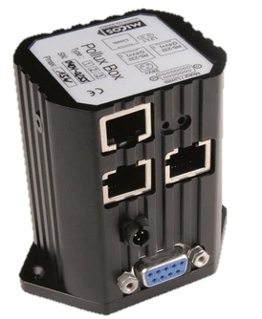
POLLUX

Slide 2
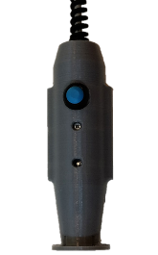
SKIN

Slide 3
TE77

Slide 4
12

